Slide 1

Course Work 3: Machine Learning Project Report
Data Preprocessing, Model Training, and Evaluation

Slide 2

Introduction
Report Objective: Present findings and results of a comprehensive machine learning project.
Data Preprocessing: Extracted three diverse datasets from repositories and applied preprocessing.
Preprocessing Steps: Cleaning, transforming, and preparing data for model training.
Model Training: Employed preprocessed datasets to train models for classification, clustering, and regression tasks.
Model Validation: Evaluated model performance using various approaches.
Results Analysis: Visualized and analyzed the outcomes of the trained models.
Detailed Overview: Subsequent sections will delve into the methodology and outcomes of each project stage.

Slide 3

Classification Problem - Introduction
Problem: Cyberbullying detection and classification using machine learning.
Objective: Develop automated methods to detect and classify cyberbullying behavior in text data.
Dataset: Collected from various sources (Twitter, YouTube, Kaggle, etc.) and labeled for cyberbullying behavior.

Slide 4
Dataset Description
Dataset sourced from Kaggle, focusing on suspicious online messages.
Binary classification: 1 (suspicious) and 0 (non-suspicious).
Features:
Text, User Information,
Timestamp,
Platform.

Slide 5

Exploratory Data Analysis (EDA)
Target Variable Distribution
Word Cloud (Most frequent words).
Message Length Distribution (Histogram).
Class Distribution (Pie chart).

Slide 6
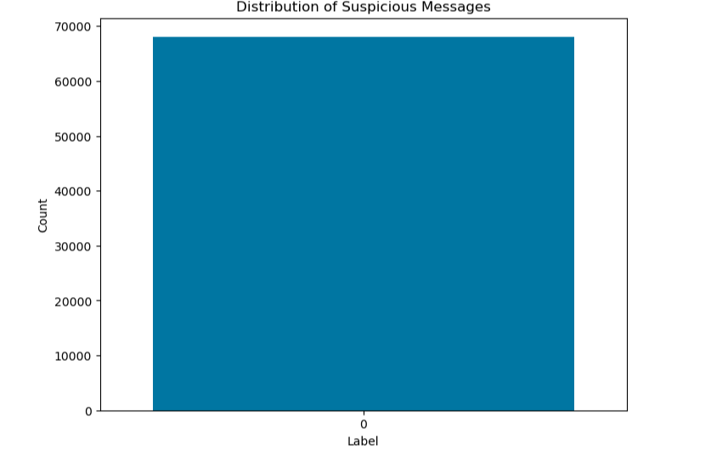
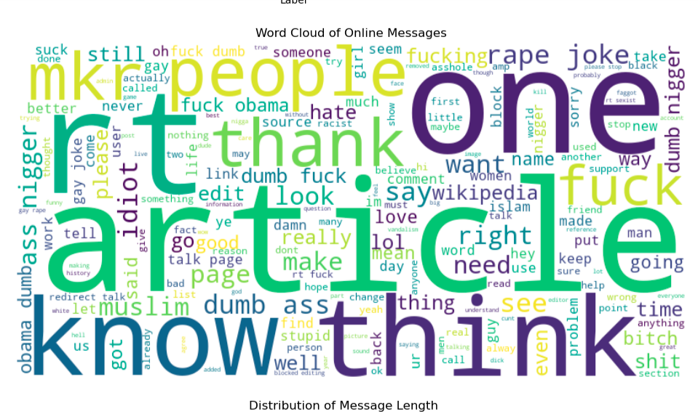
Target Variable Distribution Word Cloud (Most frequent words).

Slide 7
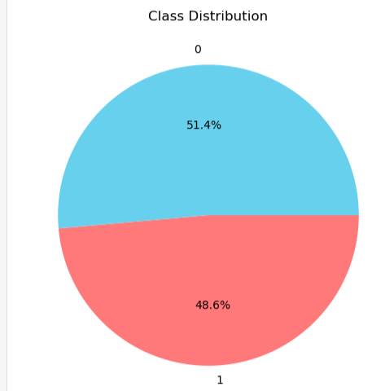
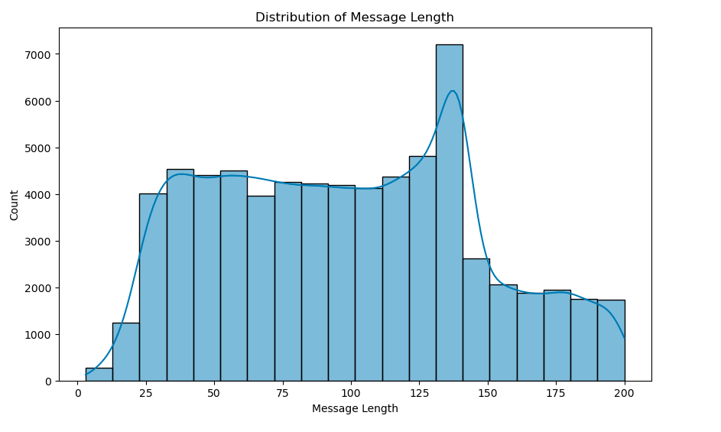
Message Length Distribution. Class Distribution (Pie chart).

Slide 8
Preprocessing
Handling missing data using (dropna()).
Removing duplicate instances (drop_duplicates()).
Text Cleaning:
Remove URLs, special characters, non-ASCII characters, numbers, stopwords.
Convert text to lowercase.
Train-Test Split (75% training, 25% validation).
Data transformation using CountVectorizer (bag of words)
Converts data into numeric feature vectors, representing word frequency
Feature extraction:
Text extracted and made into a bag of words
Sparse Matrix conversion to handle memory constraint by converting feature vectors into a sparse matrix format

Slide 9

Model Selection and Training
Algorithms used:
LinearSVC: simple and effective algorithm that is often used as a baseline for other classification algorithms
MultinomialNB: : Multinomial naive Bayes is a probabilistic algorithm that is often used for text classification
Logistic Regression: Logistic regression is a parametric algorithm that is often used for classification tasks.
KNeighborsClassifier: KNN is a non-parametric algorithm that is often used for classification and regression tasks
Hyperparameter tuning using GridSearchCV.

Slide 10
Evaluation Metrics
Accuracy: Measures the proportion of correct predictions out of total predictions.
Precision: Calculates the proportion of true positive predictions out of predicted positives.
Recall: Measures the proportion of true positive predictions out of actual positive instances.
F1 Score: Harmonic mean of precision and recall, providing a balanced measure of the model's performance
Confusion Matrix: Tabular representation of model predictions, displaying true positives, true negatives, false positives, and false negatives.
ROC Curve and AUC: : ROC curve plots TPR against FPR, while AUC summarizes the curve's performance, indicating the model's ability to discriminate between positive and negative instances.

Slide 11
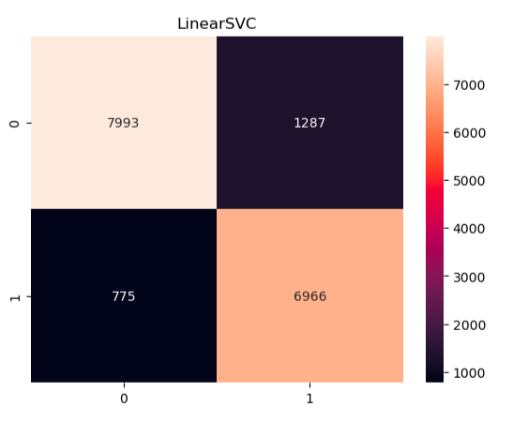
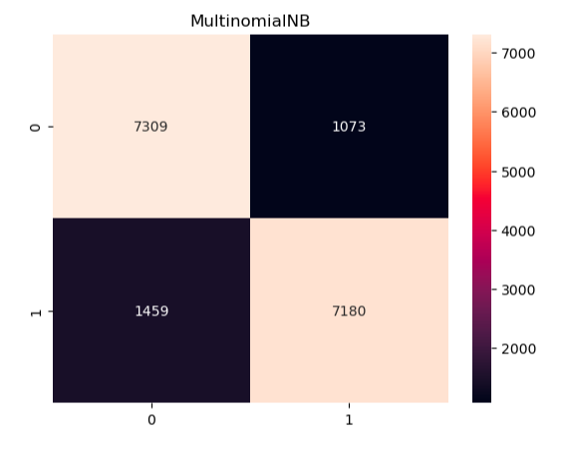

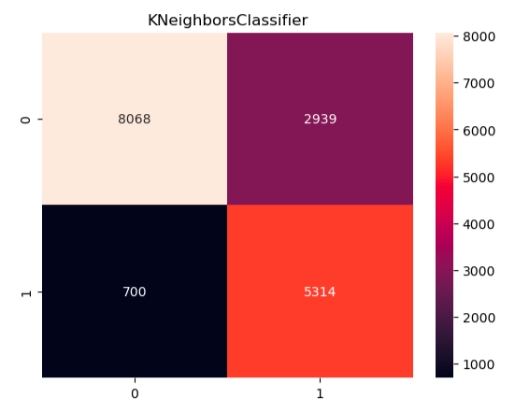
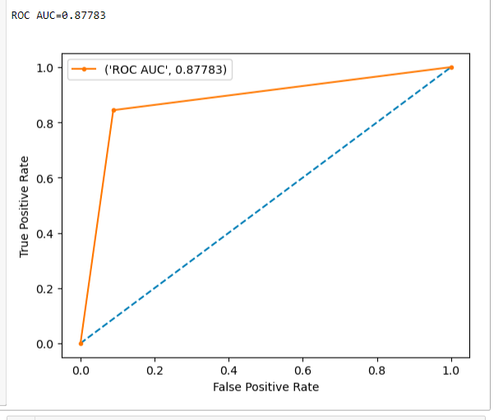
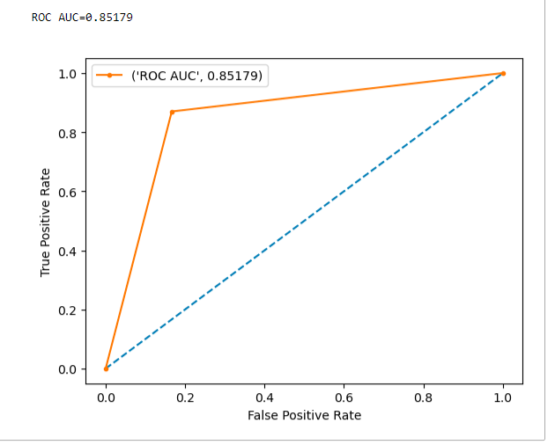
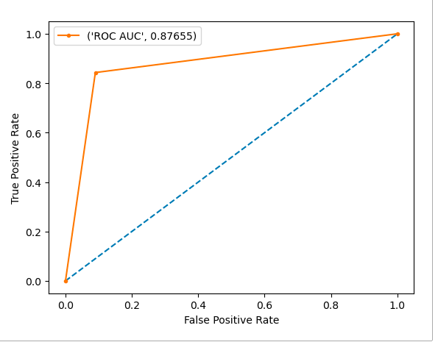
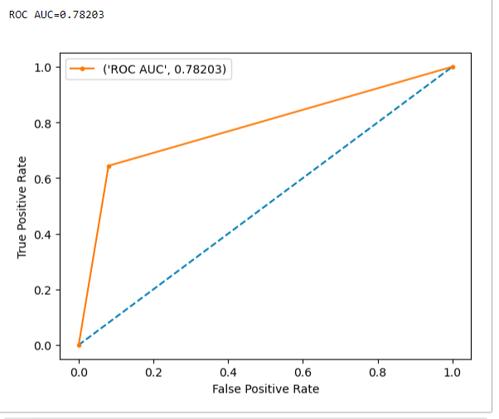
Confusion Matrix and ROC AUC
Logistic regression kNN

Slide 12
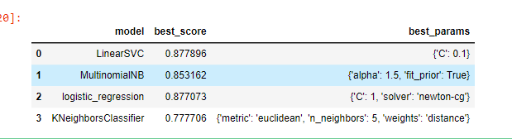
Results and Analysis
Performance comparison of algorithms with best parameters:
LinearSVC: 88% accuracy
MultinomialNB: 85% accuracy
Logistic Regression: 88% accuracy
KNeighborsClassifier: 79% accuracy
MODEL | ACCURACY
LinearSVC | 88%
Multinomial Naïve bayes | 85%
Logistic Regression | 88%
KNeighborsClassifier | 79%

Slide 13

Conclusion – Summary of Project Approach
The project aimed to develop an effective cyberbullying detection and classification system.
Extracted and preprocessed textual data from various online sources, including social media platforms and forums.
Employed Natural Language Processing (NLP) techniques to tokenize, clean, and vectorize the text data.
Utilized machine learning algorithms, such as Support Vector Machines (SVM) and Naive Bayes, for classification.

Slide 14

Conclusion – Summary of Project Findings
Successfully trained and validated the cyberbullying classification models.
Achieved high accuracy in distinguishing between cyberbullying and non-cyberbullying content.
Identified key linguistic patterns and features associated with cyberbullying behavior.
Demonstrated the models' ability to generalize and detect cyberbullying across different online platforms.

Slide 15

Conclusion – Importance of Effective Cyberbullying Detection
Cyberbullying poses significant emotional and psychological risks to individuals, especially young users.
Rapidly detecting and classifying cyberbullying content is crucial for early intervention and support.
By identifying and flagging cyberbullying instances, platforms can take proactive measures to prevent harm.

Slide 16
Conclusion – Project’s Contribution to Safer Online Environment
The developed classification system can be integrated into social media platforms and online forums.
Real-time monitoring and prompt action against cyberbullying can create safer and more inclusive online spaces.
Building a culture of respect and empathy in online interactions to promote positive digital experiences for all users.

Slide 17

PART TWO
REGRESSION PROBLEM

Slide 18

Regression Problem - Introduction
Purpose: Analyze the Graduate Admission 2 dataset and predict the chances of admission.
Features: GRE Score, TOEFL Score, University Rating, SOP, LOR Strength, CGPA, Research, and Chance of Admission.
Objective: Develop regression models and evaluate their performance using metrics.

Slide 19

Dataset Description
Source: Kaggle - Graduate Admission 2 dataset.
Features: GRE Score, TOEFL Score, University Rating, SOP, LOR Strength, CGPA, Research, and Chance of Admission.
Target Variable: Chance of Admission (0 to 1).

Slide 20

Exploratory Data Analysis (EDA)
Display first few rows and summary statistics.
Visualizations:
Histogram: Distribution of numerical variables.
Bar Plot: Count of categorical variables.
Scatter Plot: Relationship between numerical variables.
Box Plot: Summary of numerical variable distribution.
Correlation Matrix & Heatmap: Visualize correlations.

Slide 21
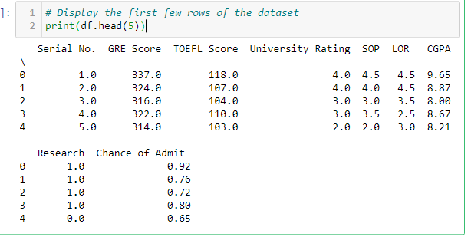
Display first few rows and summary statistics.

Slide 22
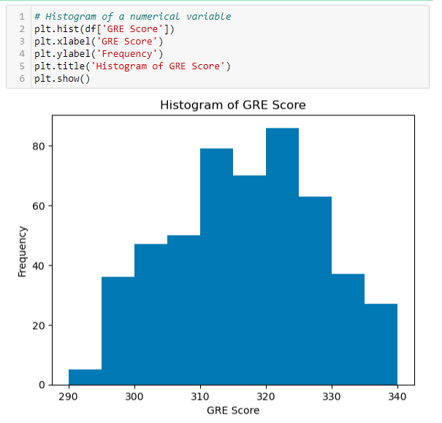
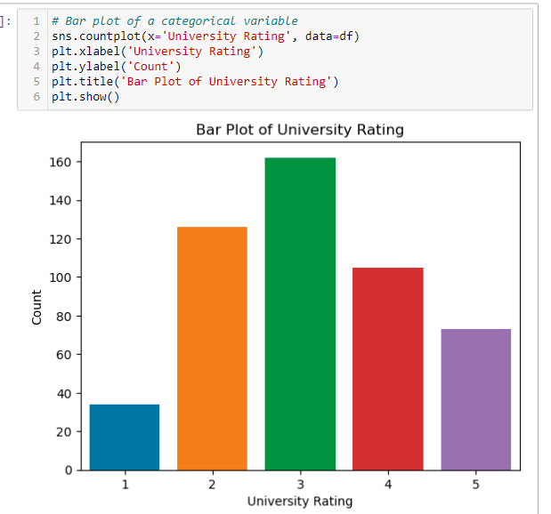
Visualizations
Histogram * bar plot

Slide 23
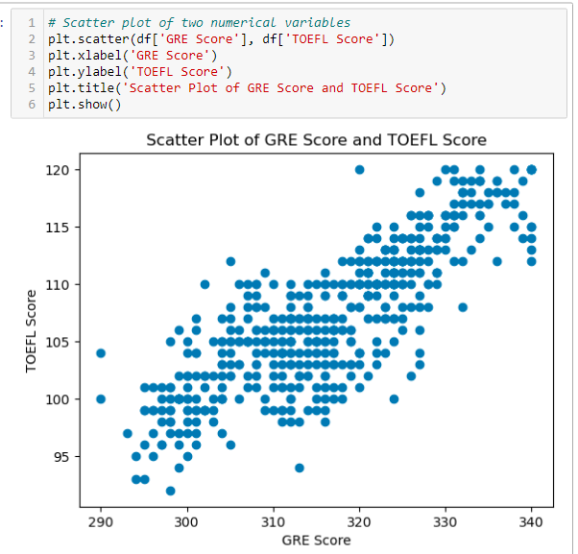
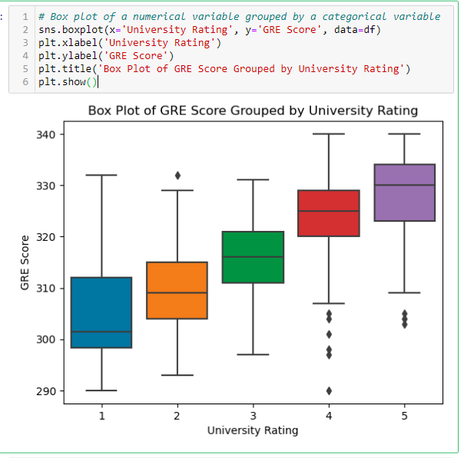
Visualizations
Scatter Plot * Box plot

Slide 24
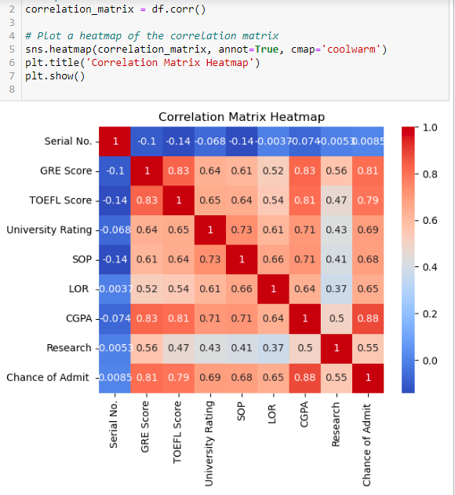
Confusion Matrix

Slide 25
Preprocessing
Missing Values: Imputed using mean imputation.
Duplicate Removal: Removed duplicates using drop_duplicates().
Outlier Detection: Handled using Interquartile Range (IQR) method.
Influential Data Points: Detected using leverage scores.
Data Imbalance: Addressed using oversampling technique.
Feature Normalization: Applied Standard Scalar for balancing the training dataset.
Feature Selection: Used Principal Component Analysis PCA for dimensionality reduction.

Slide 26

Model Selection and Training
Algorithms: Decision Tree, Random Forest, K-Nearest Neighbors, and XGBoost.
Rational of choice of algorithm: All 3 are regression algorithms.
Cross-Validation: Evaluated models using cross-validation technique (CV=5).
Default Parameters: Scoring=’neg_mean_squared_error’, remaining as default.
Performance Metrics: MSE, RMSE, MAE, R-squared score, Explained Variance Score, Median Absolute Error.

Slide 27

Evaluation Metrics
Mean Squared Error (MSE): Measures average squared difference between predicted and actual values.
Root Mean Squared Error (RMSE): Square root of MSE, measures average error.
Mean Absolute Error (MAE): Measures average absolute difference between predicted and actual values.
R-squared Score: Measures how well the model fits the data.
Explained Variance Score: Measures how much variance in data is explained by the model.
Median Absolute Error: Median absolute difference between predicted and actual values.

Slide 28
Results and Analysis
Performance of Models: Display MSE, RMSE, MAE, RSS, ESV, Median Absolute Error.
MODELS | MSE | RMSE | MAE | RSS | ESV | MEDIAN ABSOLUTE ERROR
Decision Tree | 0.003 | 0.055 | 0.028 | 0.912 | 0.912 | 3.330
Random forest | 0.002 | 0.044 | 0.0245 | 0.942 | 0.943 | 0.0023
KNN | 0.0023 | 0.050 | 0.0274 | 0.924 | 0.926 | 0.0060
XGBoost | 0.0017 | 0.041 | 0.0237 | 0.949 | 0.950 | 0.0014

Slide 29
Cross-Validation: Present predicted values for each K-value in the models.
Cross-validation | ACTUAL | DECISION TREE | RANDOM FOREST | KNN | XGBoost
K VALUE
 |  | PREDICTED
K=0 | 0.92 | 0.92 | 0.93 | 0.93 | 0.92
K=1 | 0.76 | 0.76 | 0.77 | 0.78 | 0.76
K=2 | 0.72 | 0.72 | 0.67 | 0.51 | 0.72
K=3 | 0.80 | 0.80 | 0.75 | 0.74 | 0.80
K=4 | 0.65 | 0.65 | 0.62 | 0.51 | 0.65

Slide 30
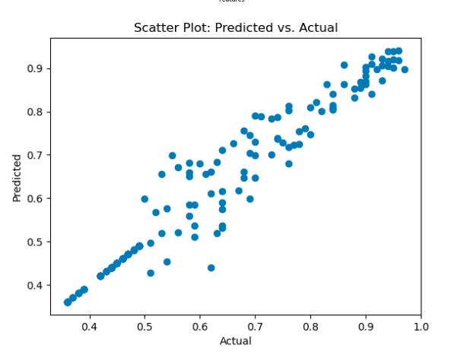
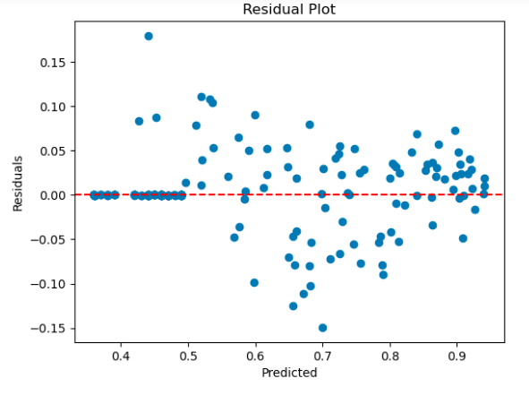
Scatter Plot: Show actual vs. predicted results And Residual Plot: Visualize residuals.

Slide 31

Summary Of Regression Analysis And Model Performance.
The results indicated that the Random Forest Regression model outperformed other models in terms of predictive accuracy. It exhibited the lowest MSE and RMSE values and the highest R-squared score, indicating its ability to explain a significant portion of the variance in the data.

Slide 32

Importance Of Predicting Graduate Admission Chances.
Predicting graduate admission chances holds immense importance for both universities and prospective students. For universities, it assists in the selection process by objectively assessing applicants' likelihood of success. Admissions committees can use the predicted chances to identify promising candidates, enhancing the efficiency of the selection process.
For prospective students, knowing their predicted admission chances helps in making informed decisions about which universities to apply to. It allows them to focus on institutions where they have a higher likelihood of acceptance, optimizing their application efforts and increasing the chances of getting admitted to their desired programs.

Slide 33
Potential Implications For Universities And Prospective Students.
Efficient Resource Allocation: Universities can allocate their resources effectively by focusing on the most suitable applicants. By predicting admission chances, they can manage their capacity and resources better, ensuring the enrollment of well-suited students.
Improved Student Experience: Prospective students benefit from understanding their admission probabilities, allowing them to make strategic choices while applying. This leads to a more streamlined application process, reducing stress and uncertainty for applicants.
Enhanced Diversity: Predictive models can aid universities in promoting diversity by considering a wide range of applicants and ensuring fair selection based on merits and potential.

Slide 34

PART 3
CLUSTERING PROBLEM

Slide 35

Clustering Problem - Introduction
Purpose: Analyze the Marketing Campaign dataset using clustering techniques to gain insights into customer segmentation and enhance marketing strategies.
Dataset: Contains 2,240 entries and 29 attributes.
Attributes: ID, Year_Birth, Education, Marital_Status, Income, Kidhome, Teenhome, Dt_Customer, Recency, and more.
Objective: Utilize clustering analysis to group similar customers based on behavior, demographics, and responses to marketing campaigns.

Slide 36

Dataset Description
Dataset Structure: 2,240 entries, 29 columns.
ID: A unique identifier for each individual in the dataset.
Year_Birth: The birth year of the individual, representing their age.
Education: The level of education attained by the individual.
Marital_Status: The marital status of the individual.
Income: The income of the individual.
Kidhome: The number of children living at home for the individual.
Teenhome: The number of teenagers living at home for the individual.
Dt_Customer: The date when the individual became a customer.
Recency: The number of days since the individual's last purchase or interaction with the company. etc
Missing Values: 24 missing values in the 'Income' attribute

Slide 37

Exploratory Data Analysis (EDA)
Overview: Display the head of the dataset and explore its shape.
Summary Statistics: Provide insights into numerical attributes.
Material Status Analysis: Visualize marital status after preprocessing.
Income Distribution: Show income distribution after preprocessing.
Age Distribution: Present age distribution after preprocessing.
Spending Distribution: Display spending distribution.

Slide 38
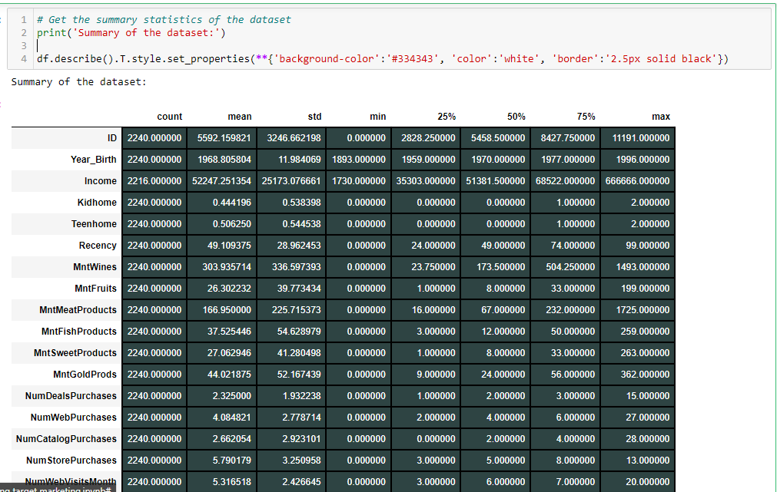
Overview: Display the head of the dataset and explore its shape.

Slide 39
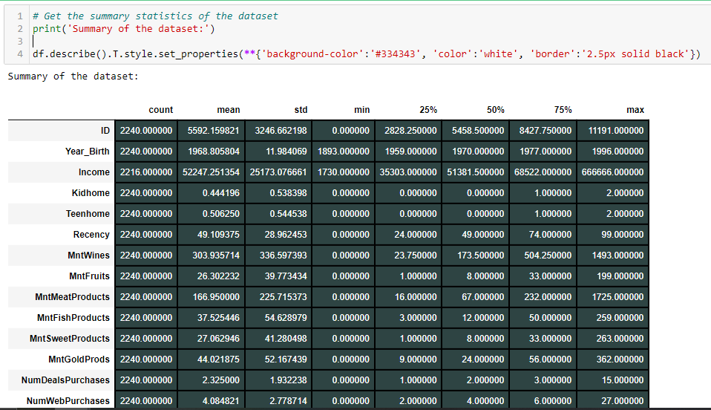
Summary Statistics: Provide insights into numerical attributes.

Slide 40
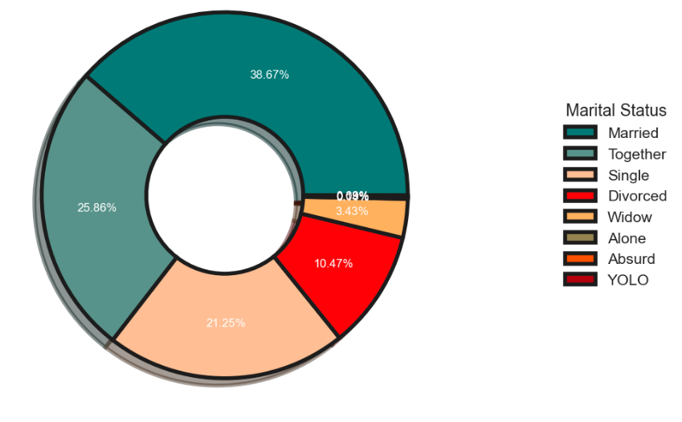
Material Status Analysis: Visualize marital status after preprocessing.

Slide 41
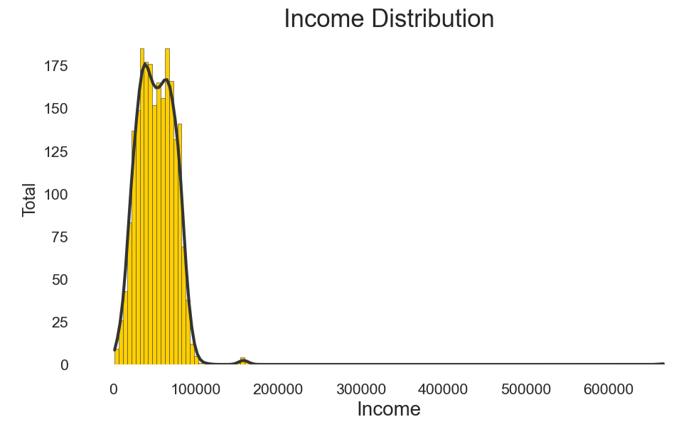
Income Distribution: Show income distribution after preprocessing.

Slide 42
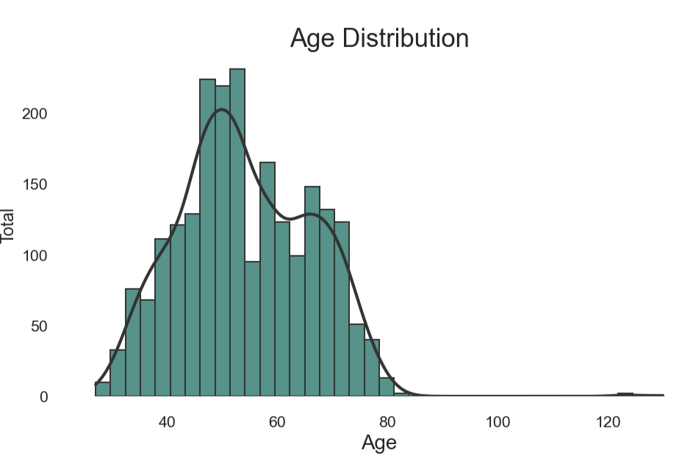
Age Distribution: Present age distribution after preprocessing.

Slide 43
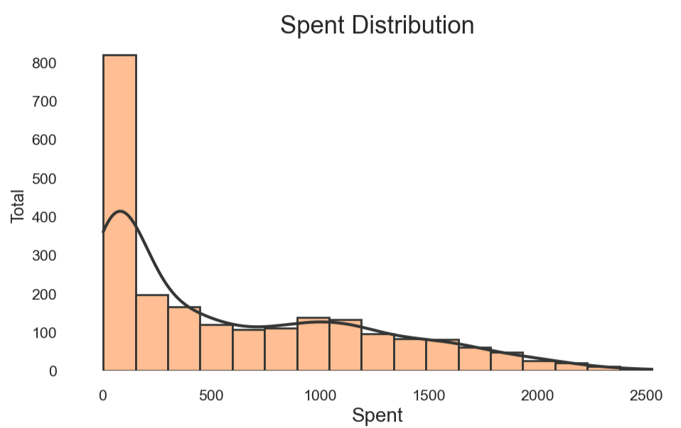
Spending Distribution: Display spending distribution.

Slide 44

Preprocessing
Missing
Missing Values: Handle missing values in the 'Income' attribute.
Duplicate
Duplicate Removal: Ensure no duplicate entries in the dataset.
Feature
Feature Transformation: Transform the 'Dt_Customer' column into a datetime datatype for machine learning.
Normalizing
Normalizing Data: Normalize data for better performance in clustering algorithms.
Use
Dimensionality Reduction: Use Principal Component Analysis (PCA) to reduce dimensionality.
Feature
Feature Selection: Select relevant features for clustering.

Slide 45
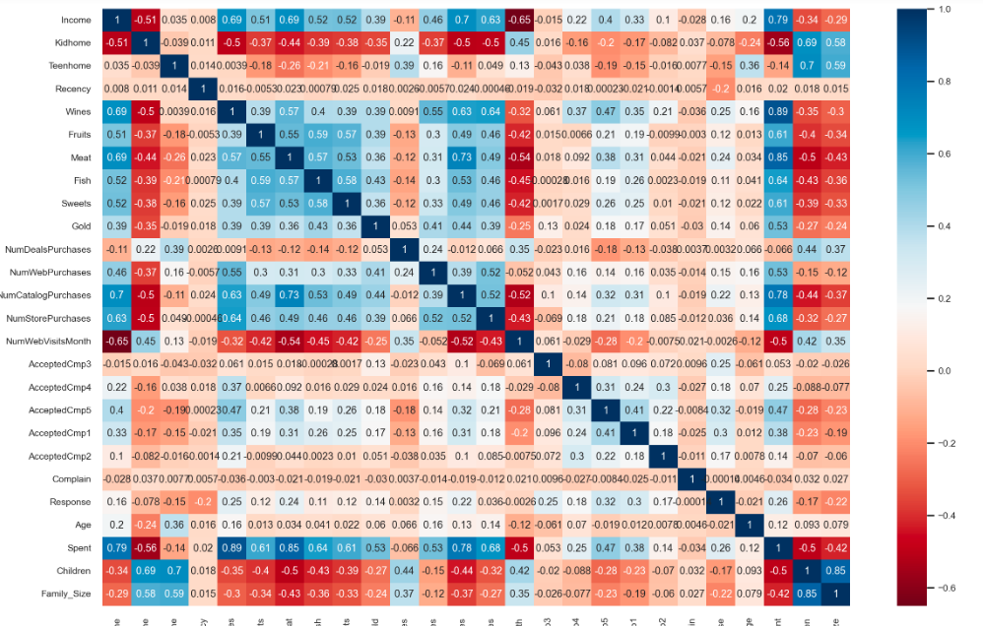
Confusion matrix of the dataset after preprocessing

Slide 46

Model Selection and Training
Algorithms: Three clustering algorithms used - Agglomerative Clustering, DBSCAN, and K-Means.
Evaluation Metrics: Metrics used to assess clustering quality - WCSS, BCSS, Silhouette Score, and Davies-Bouldin Score.

Slide 47
K-Means Clustering and Default parameters
This is a partitional clustering algorithm that works by grouping data points into k clusters.
The default parameters for K-Means are:
n_clusters: The number of clusters to be created = 4.
init: The method used to initialize the cluster centroids. The default initialization method is random = 10.
n_init: The number of times the K-Means algorithm is run with different random initializations. The best model is then chosen based on the inertia score.

Slide 48
Agglomerative Clustering and default parameters
Agglomerative Clustering: This is a hierarchical clustering algorithm that works by merging similar clusters together.
The default parameters for Agglomerative Clustering are:
n_clusters: The number of clusters to be created = 4.
linkage: The linkage criterion to be used. The linkage criterion determines how clusters are merged together. The default linkage criterion is used.

Slide 49

DBSCAN and default parameters used
DBSCAN: This is a density-based clustering algorithm that works by finding clusters of high density.
The default parameters for DBSCAN are:
eps: The maximum distance between two points to be considered as part of the same cluster. 0.5
min_samples: The minimum number of points required to form a cluster = 10

Slide 50

Evaluation Metrics
WCSS (Within-Cluster Sum of Squares): WCSS measures the compactness of clusters by calculating the sum of squared distances between each data point and the centroid of its assigned cluster. Lower WCSS indicates tighter and more homogeneous clusters.
BCSS (Between-Cluster Sum of Squares): BCSS measures the separation between clusters by calculating the sum of squared distances between the centroids of different clusters. Higher BCSS indicates distinct and well-separated clusters.
Silhouette Score:The Silhouette Score considers both cohesion within clusters and separation between clusters. It calculates the average silhouette coefficient for all data points, ranging from -1 to 1. Higher scores indicate better-defined and well-separated clusters.
Davis-Bouldin Score: The Davis-Bouldin Score measures the average dissimilarity between clusters, considering both compactness within clusters and separation between clusters. Lower scores indicate better clustering with more distinct and well-separated clusters.

Slide 51
Algorithm Performance
Algorithm | Kmeans | Agglomerative clustering | Dbscan
WCSS | 83.813 | 83.813 | 83.813
BCSS | 24.549 | 24.549 | 24.549
silhouette_score | 0.45 | 0.112 | 0.1670
davies_bouldin_score | 0.8269 | 3.3548 | 1.9515

Slide 52

Best Performing Algorithm
K-means had the highest score in terms of silhouette score and also the lowest in terms of Davis Bouldin Score hence K-means is the best of algorithm. DBSCAN followed in second place and finally the hierarchical clustering had the worse performance.

Slide 53
Analysis of Results
Cluster Analysis:
The income vs. spending analysis revealed four distinct customer clusters based on their income levels and spending habits.
Customer Segmentation:
Group 0: Medium income and high spending.
Group 1: Low income and low spending.
Group 2: High income and high spending.
Group 3: Low income and average spending.
Targeted Marketing Strategies:
Understanding customer segments allows businesses to tailor their marketing and sales efforts effectively.
Group-specific strategies can be developed, such as discounts for Group 1 and luxury offerings for Group 2.

Slide 54

Analysis of Results ….
Identifying Growth Opportunities:
The analysis helps identify underserved markets, such as Group 3 with potential for growth.
Targeting these opportunities can lead to increased sales and profits.
Valuable Customer Insights:
The income vs. spending clusters analysis provides valuable insights into customer behavior and preferences.
Businesses can make data-driven decisions to enhance customer satisfaction and loyalty.
Enhancing Business Performance:
By leveraging customer segmentation, businesses can optimize their marketing efforts and drive better results.
Identifying growth areas can fuel business expansion and success.

Slide 55
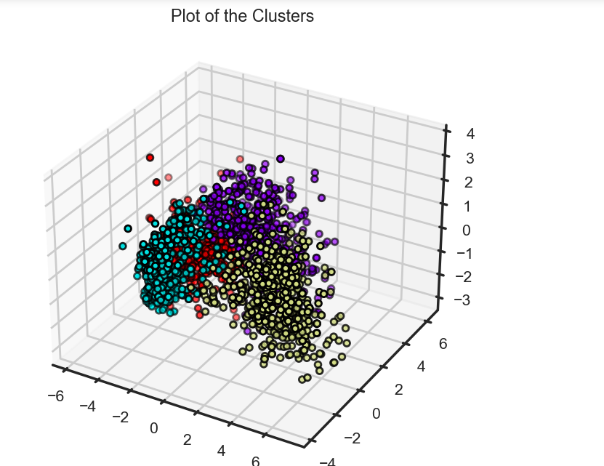
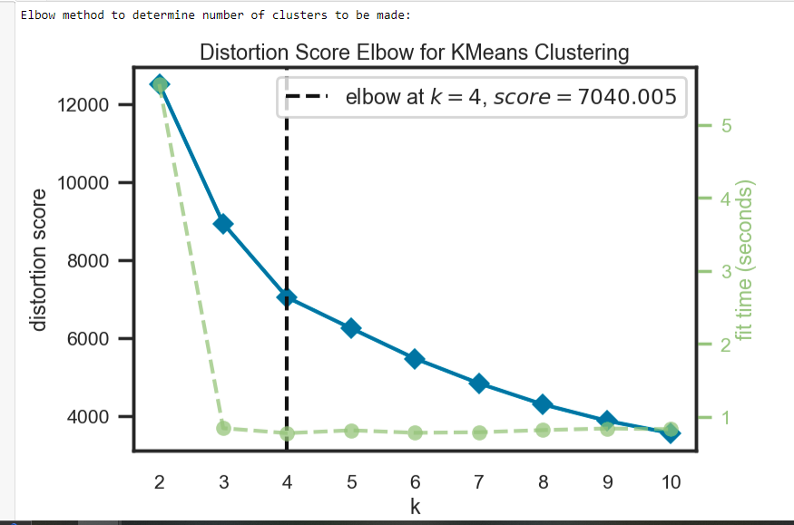
Plot of clusters And Scatter plot of clusters

Slide 56

Conclusion – Importance of Clustering for Enhancing Marketing Strategies
Clustering enables businesses to understand customer behavior and preferences.
It helps identify unique customer segments with different needs and characteristics.
Enhanced understanding of customer segments allows targeted and personalized marketing strategies.

Slide 57

Potential Benefits and Applications in Targeted Marketing Campaigns
Targeted Marketing: Tailor marketing messages and offers to each customer segment's preferences.
Resource Allocation: Allocate marketing resources more efficiently by focusing on high-potential segments.
Product Development: Develop products or services that cater to the specific needs of different segments.
Customer Retention: Improve customer retention by providing personalized experiences.

Slide 58

Conclusion
Clustering analysis provides valuable customer segmentation insights.
Enhances marketing strategies through personalized targeting.
Enables businesses to optimize resource allocation and improve customer satisfaction.
Utilizing customer segmentation can lead to increased customer engagement and higher ROI in marketing efforts.

